Slide 1
Objective
Go through multiple research papers to find out about existing techniques to tackle cooling plate design generation under variable heat flux conditions ( We got around 3 techniques out of which the one used was more practical using GEN AI ).
Collect and extract data from COMSOL for varying cooling plates with varying conditions of heat flux.
Build a VAE model based NN and generate a cooling plate using it.
Try building a 3D model from the generated cooling plate and simulate to get its heat behaviour for all ranges in heat flux.

Slide 2
Technique Followed
Data Extraction
NN Building
Final Image
Generation

Slide 3
Data Generation
I generated 81 Images for dataset as 60 were not producing a satisfactory final plate.
Each plate took around 2 hours (Avg) to produce the cooling plate design.
The Range for all 81 data set points is between 2500 to 4500 heat flux with a flux step of 25 heat flux between each data point to increase the efficiency of neural network.
All data set is shown next…

Slide 4
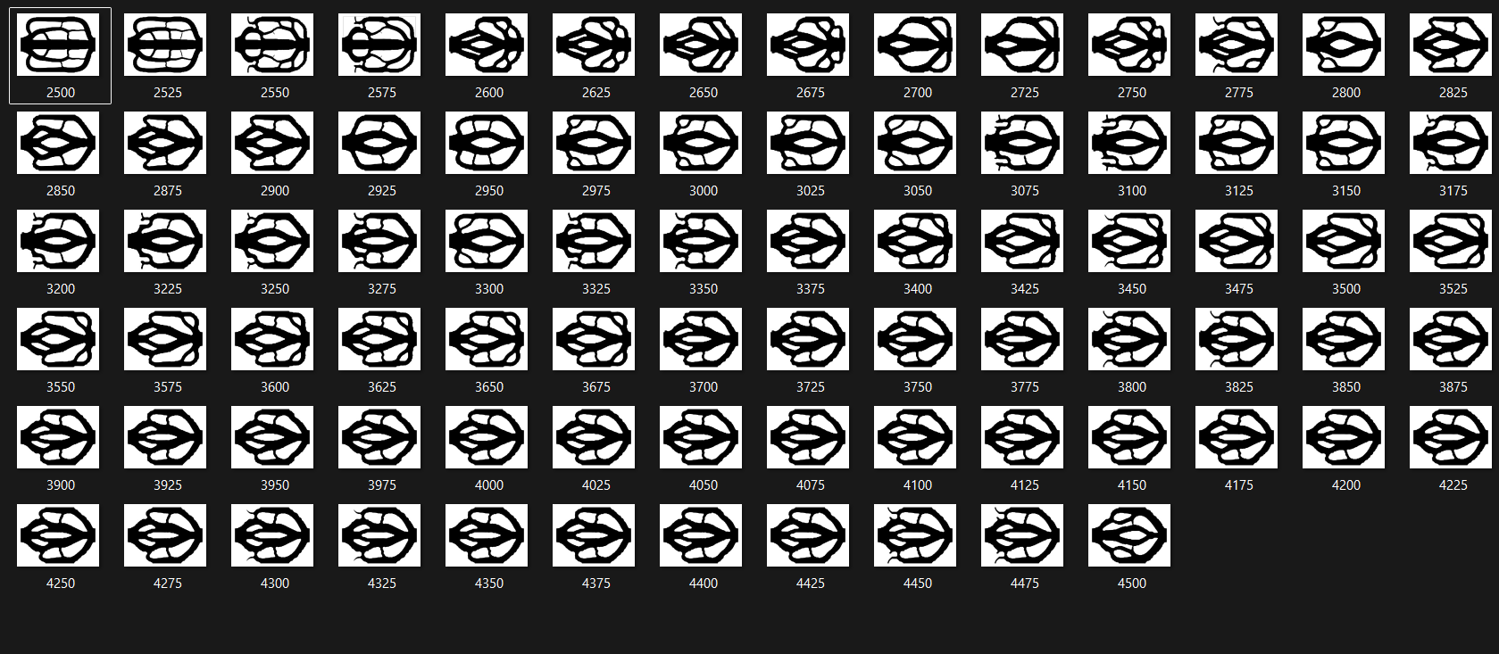
All 81 Dataset Images we generated

Slide 5
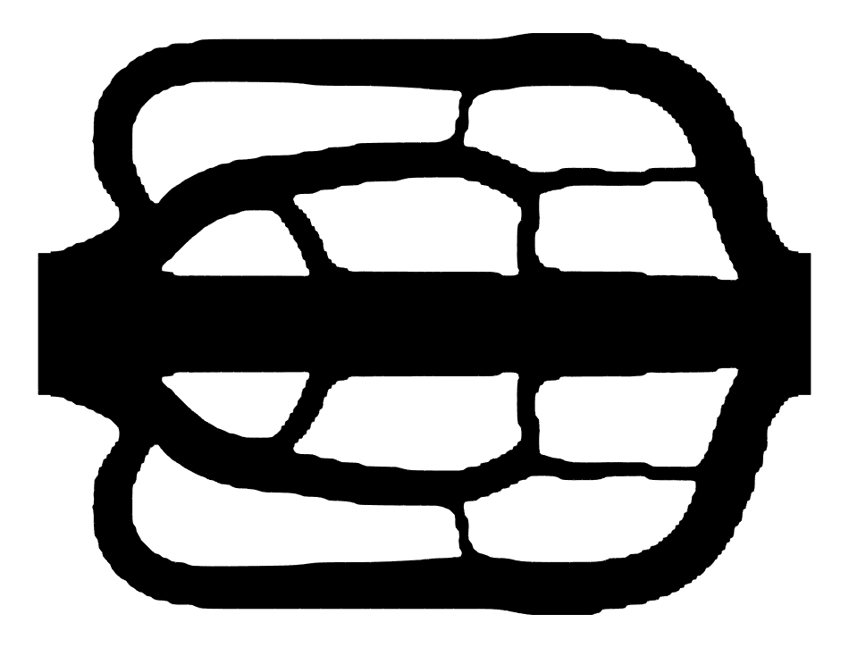

2 Sample Images for change notable
2500
2525

Slide 6
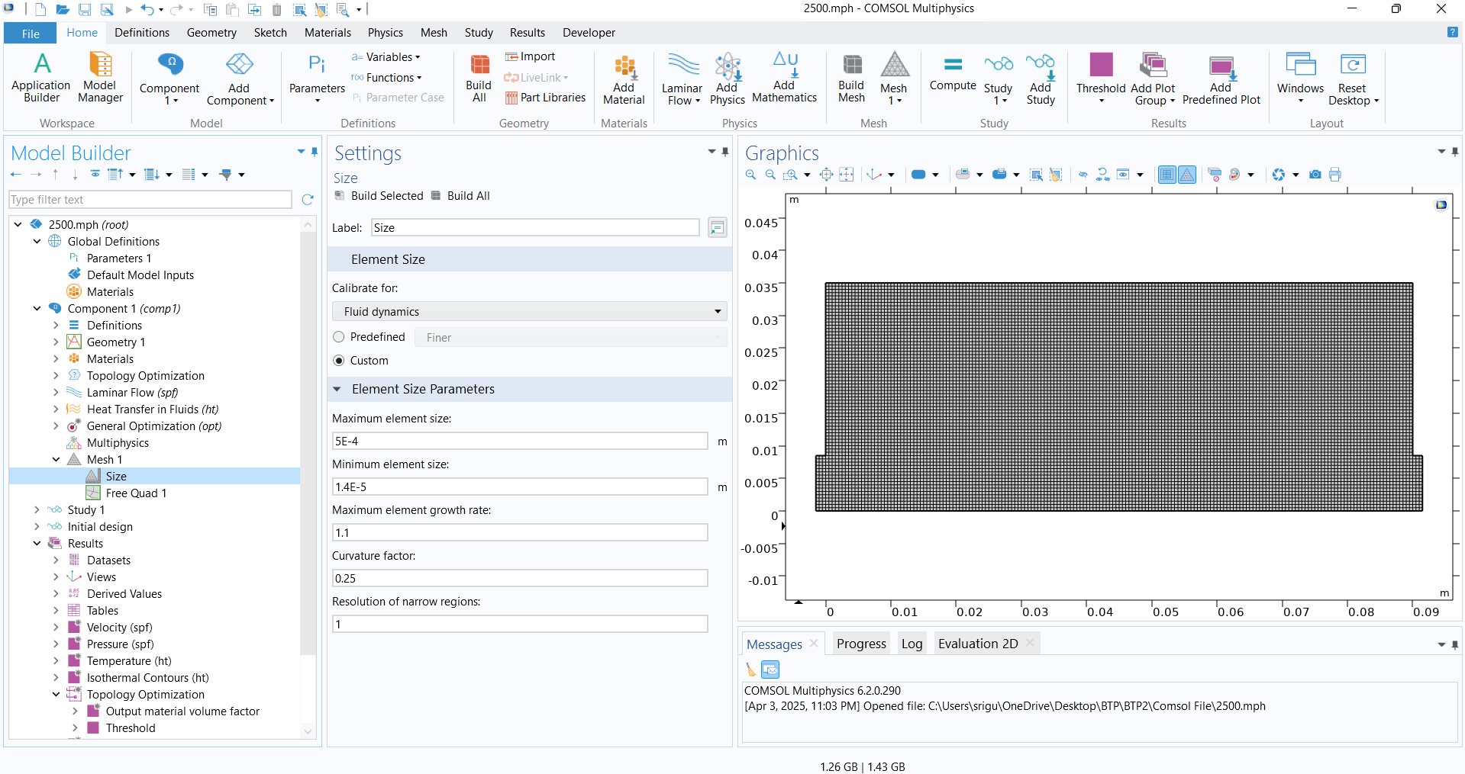
How I Extracted The Dataset Images 1) Meshing used

Slide 7
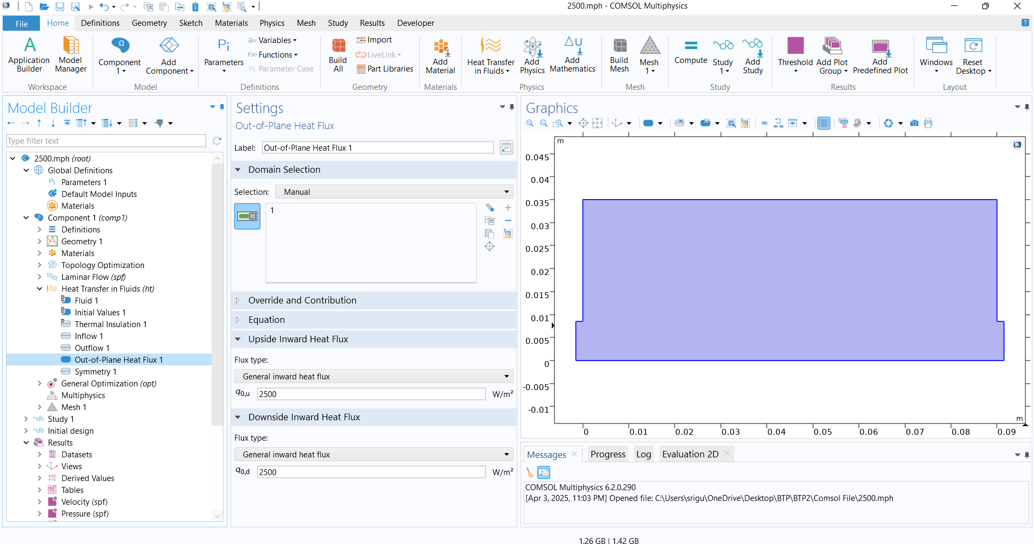
2) Heat Flux set ( Sample )

Slide 8
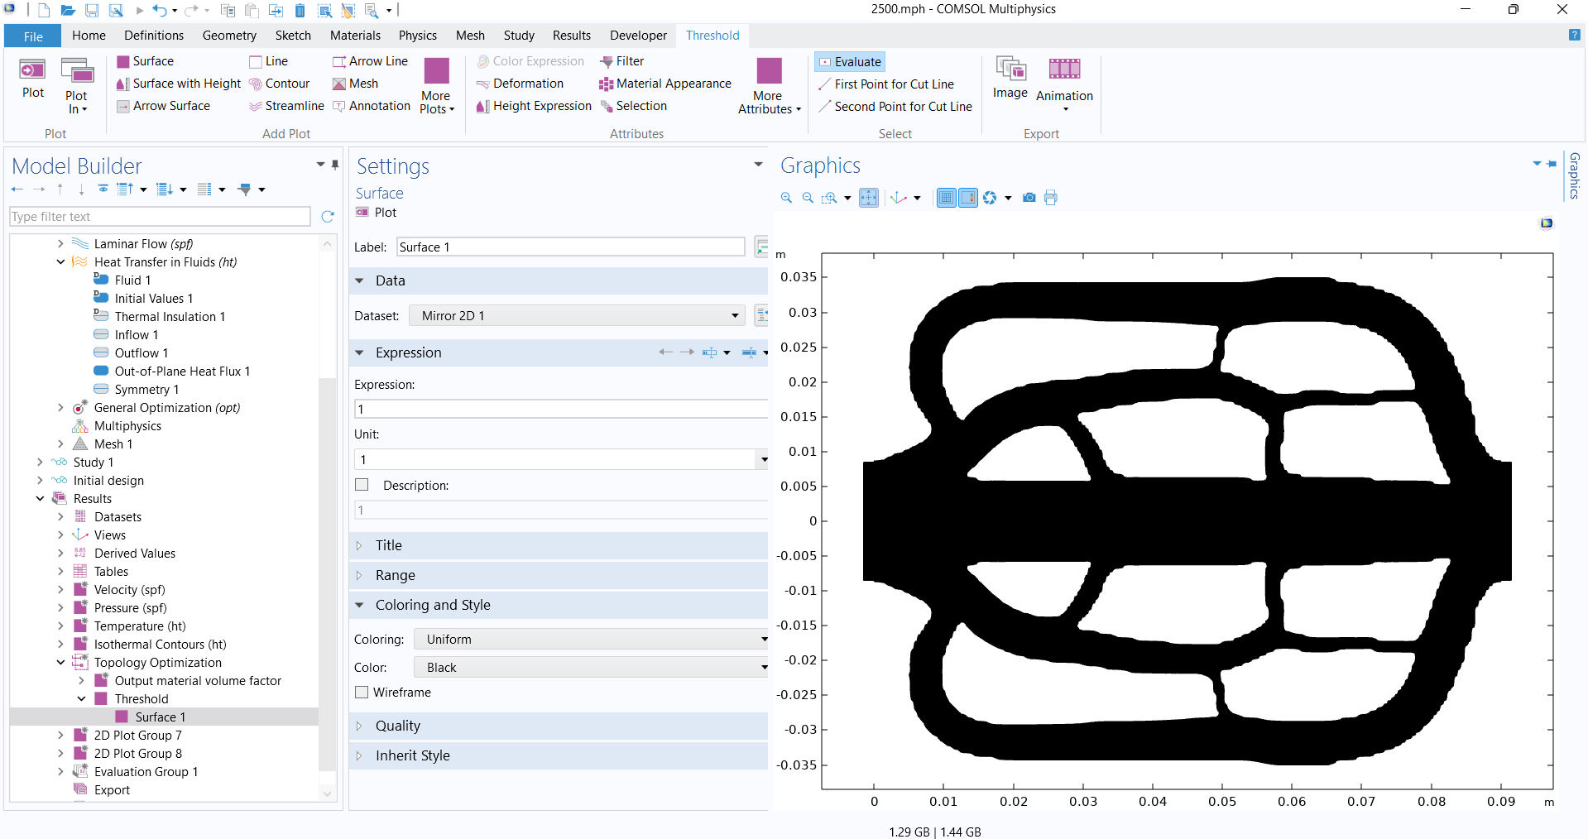
3) How I generated image

Slide 9
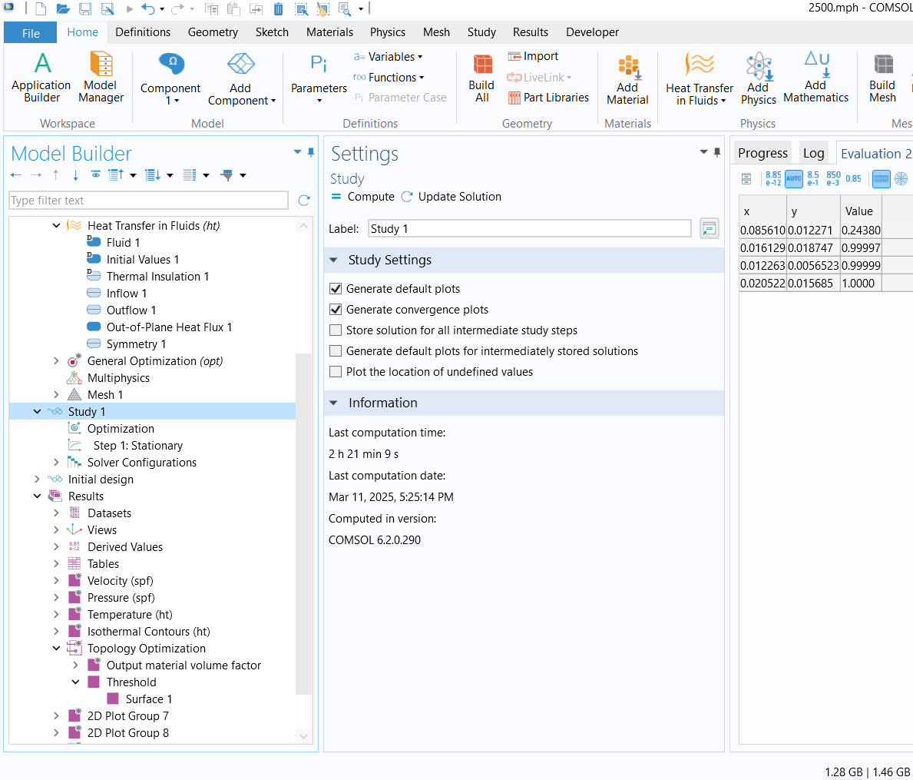
4) Computational Time Taken

Slide 10
Neural Network Build and Working
Used the Variational Autoencoder Model for Cooling Plate Image Generation Where I used PyTorch to create and train the VAE model, torchvision for image transformations and dataset utilities, PIL (Pillow) to load images and Matplotlib to visualize generated cooling plates.
The model basically trains a Variational Autoencoder (VAE) for 1024×1024 cooling plate design, Uses CNN encoder & transposed CNN decoder and finally Generates new cooling plate designs from random latent vectors.

Slide 11
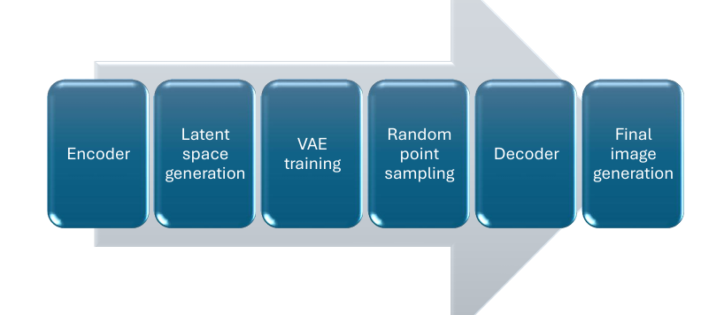
VAE Technique Overview

Slide 12
Total Technique Summarized
VAE Model Design: The Variational Autoencoder (VAE) consists of an encoder that compresses images into a latent space, a reparameterization trick to sample from this space, and a decoder that reconstructs high-resolution (1024×1024) images.
Dataset Preparation: Images are loaded from a folder, resized to 1024×1024, and converted into tensors for training.
Training Process: The model is trained using a VAE loss function (combining MSE loss and KL divergence) with the Adam optimizer over 50 epochs.
Cooling Plate Generation: After training, a random latent vector is passed through the decoder to generate new cooling plate designs, which are saved and displayed.

Slide 13
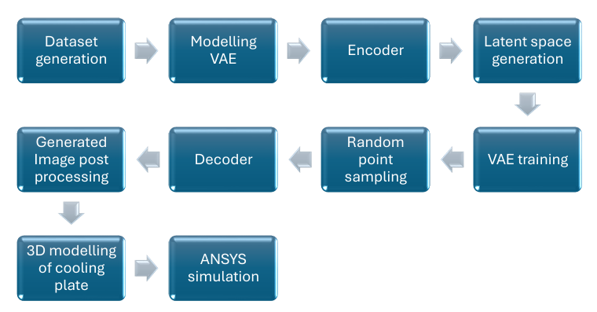
Complete Technique Overview

Slide 14
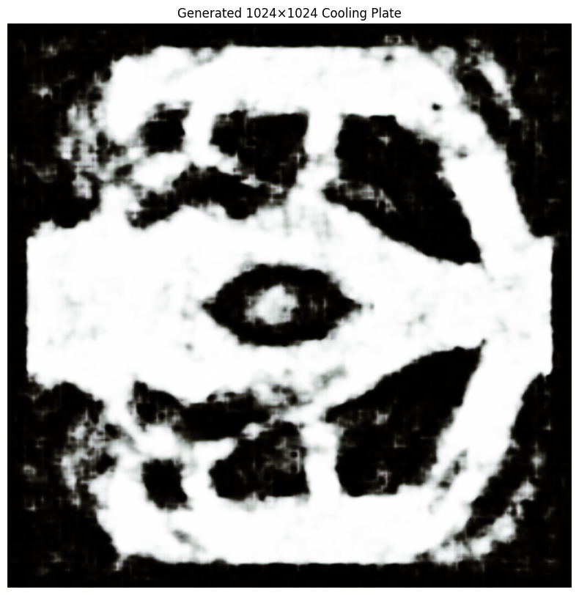
Final Generated Image

Slide 15
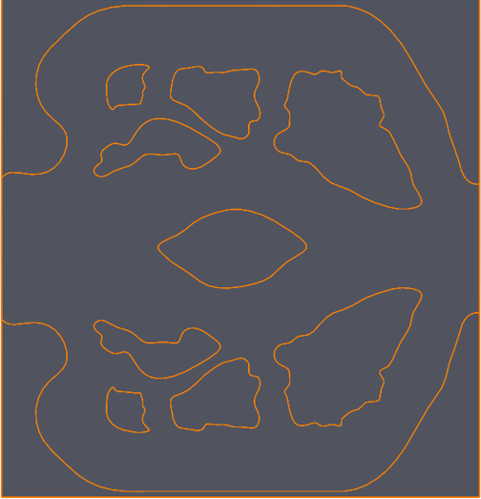
Image After Postprocessing

Slide 16
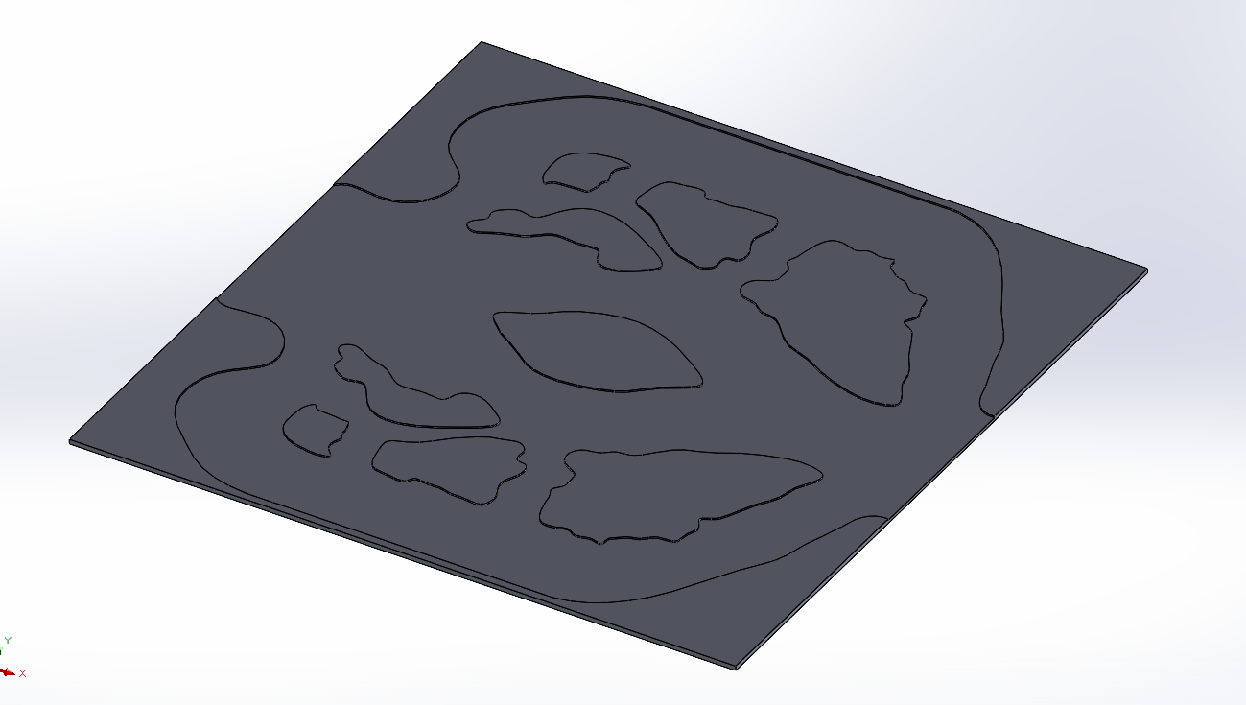
3D Model implemented in Solidworks

Slide 17
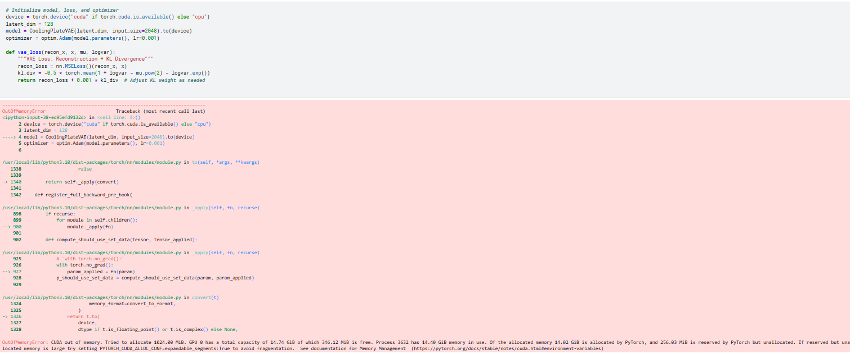
Reason for not trying with higher resolution ( 2048 and higher ) generation of image is because of the out of memory error caused.

Slide 18
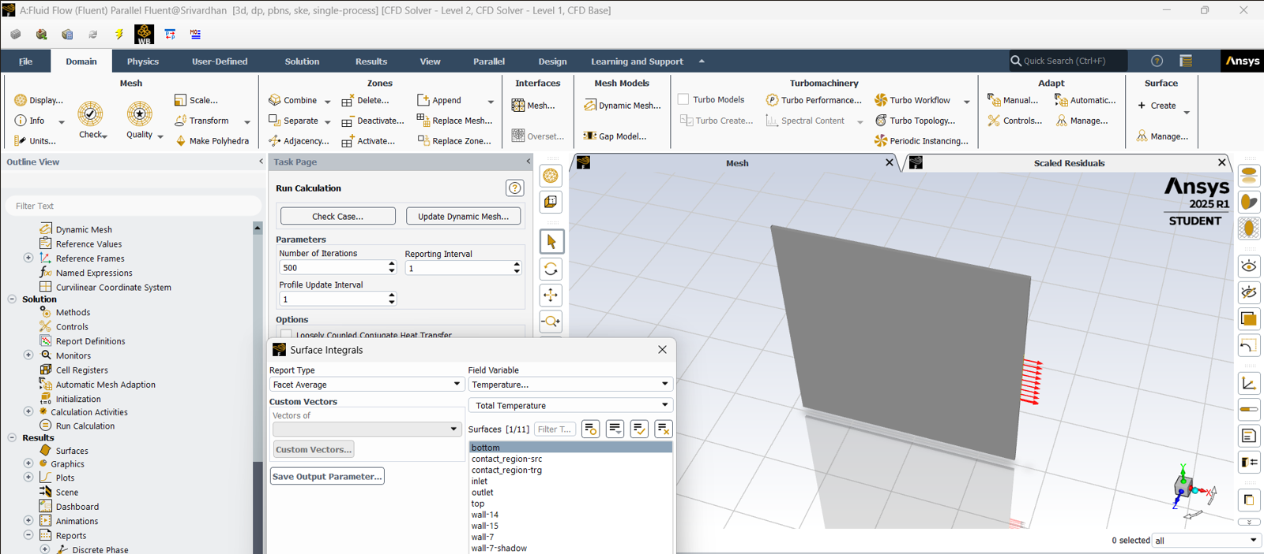
Ansys Simulation

Slide 19
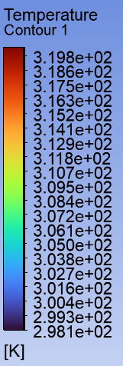
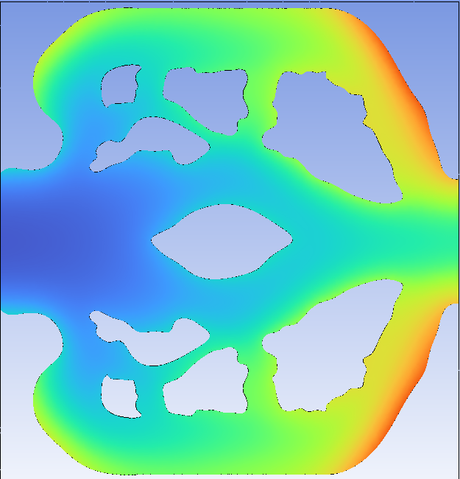
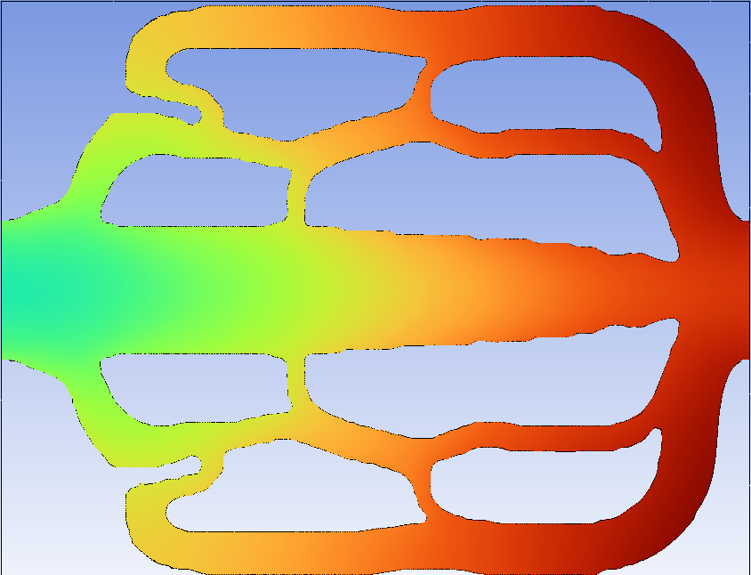
Results from Ansys Simulation

Slide 20
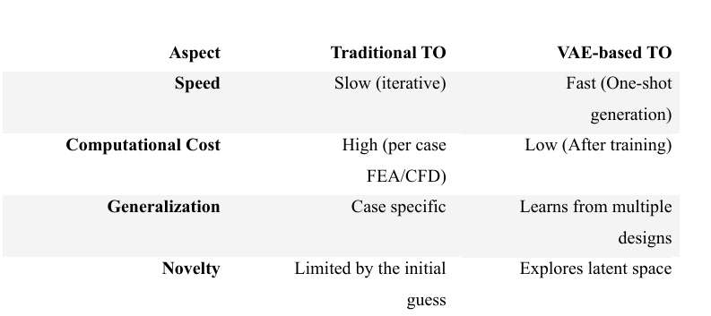
Benefits of VAE Method

Slide 21
Conclusion
Although the initial data generation for the VAE model took approximately 160 hours,
The resulting model proved to be highly versatile and beneficial.
It can also enable the development of more manufacturable and convenient cooling plate designs.
The model also demonstrated the ability to predict designs for heat flux values beyond the training range, ensuring robust generalization.

Slide 22
References
Jing-peng Wu, Huan-ling Liu, Chong-chong Li, Chun-hui Li, Gongnan Xie, “Topological optimization and thermal performance of cold plates for lithium-ion battery with non-uniform heat sources,” Applied Thermal Engineering, vol. 254, 2024, doi: 10.1016/j.applthermaleng.2024.123922.
Sanjeet Patra, Parthiv Chandra K, Wei Li, Jianhui Mou, Liang Gao, Quan Zhou & A. Garg, “Performance study of cooling plates with single and double outlets for lithium ion battery thermal management system based on topology optimization,” International Journal of Green Energy, 2023, doi: 10.1080/15435075.2023.2253886.
Rest are uploaded to - https://drive.google.com/file/d/1InGoFqB-Z9NVL41f6EmPACA3hQxVKN8v/view?usp=sharing

Slide 23
Dataset is uploaded in the below link : https://drive.google.com/drive/folders/1PGzA4Zdas4adVXO4D2mwHWunuXx4jXc3?usp=sharing
Code for VAE uploaded in the below link : https://drive.google.com/drive/folders/1clTJiTHjh9E8Z_POJUKz0hOQQhwtINQR?usp=sharing

